Slide 1
Secure data hiding in images using Steganography
Presented By: Dinesh Kumar M
College Name & Department : Bharath Institute Of Higher Education And Research & CSE(AIML)

Slide 2
OUTLINE
Problem Statement
Technology used
Wow factor
End users
Result
Conclusion
Git-hub Link
Future scope

Slide 3
Problem Statement
Data breaches cost organizations millions annually
Traditional encryption draws attention to sensitive data
Need for invisible , secure data hiding methods

Slide 4
Technology used
Programming language : Python
Libraries : OpenCV
Technique : Least Significant Bit(LSB)

Slide 5
Wow factors
Enhanced Security : Steganography combined with encryption.
High Robustness : Resists basic images manipulations.
Stealth : No visible changes in images quality
Interactive : Hidden data revealed only with the correct key.

Slide 6
End users
Government Agencies – Secure communications.
Banking & Finance – Confidential data transfer.
Journalists – Safe transmission of sensitive information.
General Public – Personal data privacy.

Slide 7
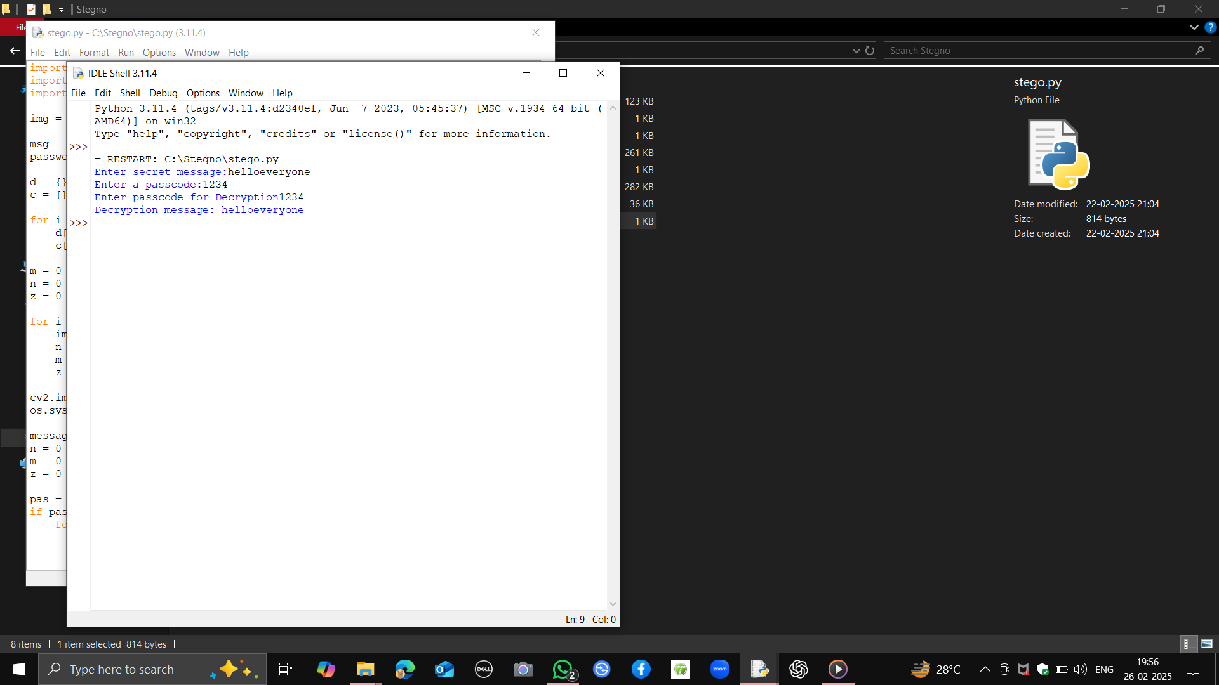
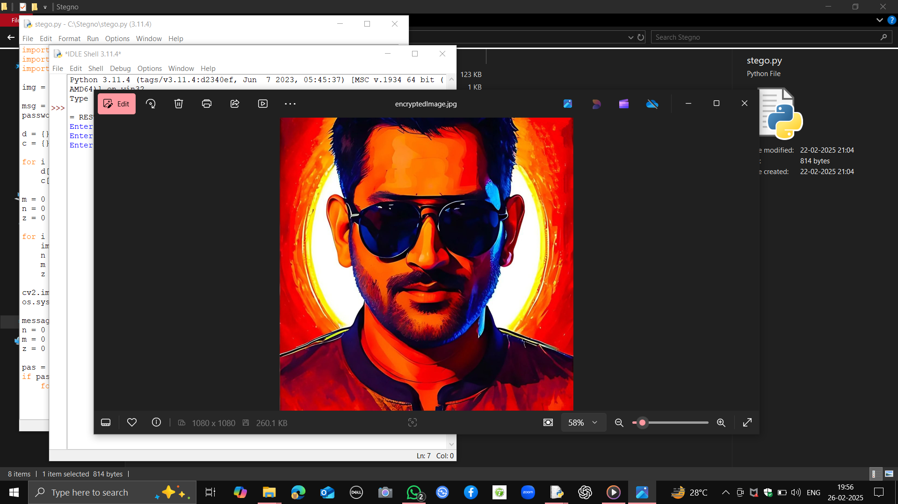
Results :

Slide 8
Conclusion
“Privacy is not a option, and it should not be the price we accept for just getting on the internet.” –Gary Kovacs.

Slide 9
GitHub Link
https://github.com/Dinesh07-sys

Slide 10
Future scope
AI-Enhanced Steganography for adaptive data hiding.
Expansion into Audio and Video Steganography.
Advanced steganalysis resistance techniques.

Slide 11
THANK YOU!!!
‘Hidden in plain sight’ – That’s the essence of steganography.

